Slide 1
ISG Sprint Demo Event: OGC and Khronos Group |
Dr. Scott Serich, Director, OGC>
September 25, 2020

Slide 2
Demo Agenda
… can be found in the GitHub repository at https://github.com/opengeospatial/OGC-ISG-Sprint-Sep-2020/wiki/ISG-Sprint-Demo-Event-Agenda .

Slide 3
Welcoming Remarks
Welcome.
Purpose of today’s event.
Who’s who?
A quick note of thanks.

Slide 4
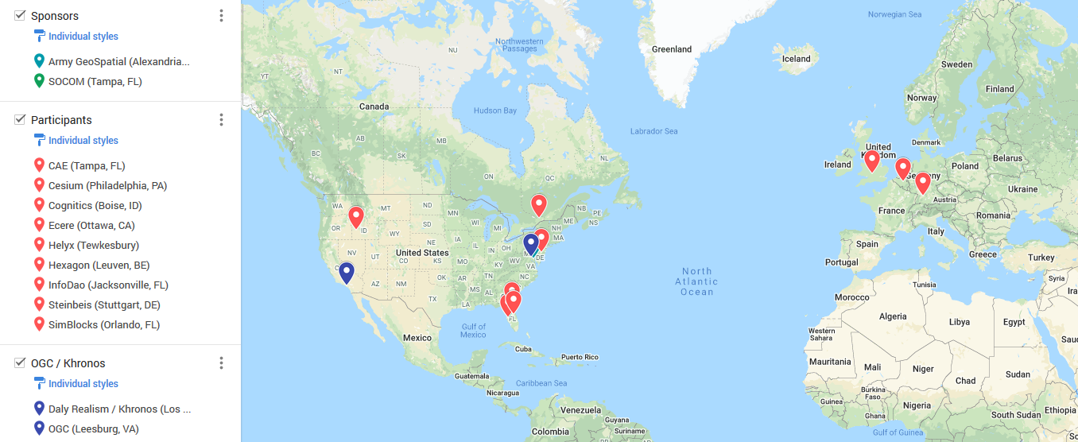
Where in the World

Slide 5
Invited Guests
Invited Guests

Slide 6
OGC 3D Data Container and Tiles API Pilot
The Pilot created a draft specification for access and query of 3D geospatial data, with a corresponding container format for streamed data delivery compatible with glTF.
Links to Pilot work products, etc. can be found under the Presentation Links wiki page (which is linked to in the Agenda).
https://github.com/opengeospatial/OGC-ISG-Sprint-Sep-2020/wiki/Presentation-Links .
The Sprint built on Pilot momentum to test additional capabilities based on San Diego geospatial source data.

Slide 7
Work Product Presentations *
CAE, Cesium, Cognitics.
Pause for Q&A.
Helyx, Ecere, InfoDao.
Pause for Q&A.
Hexagon, Steinbeis, SimBlocks.
Additional Q&A.

Slide 8
Q&A
Any additional questions or comments?
.

Slide 9
Wrap-Up and Next Steps
Upload (reworked) videos to OGC YouTube Channel
https://www.youtube.com/user/ogcvideo/playlists .
Additional TIE Testing next week.
Participant Sprint Report inputs due October 5.
AOB.

Slide 10
Thank you.
Thank you.

